Slide 1
Neural Networks II
CMPUT 466/551
Nilanjan Ray

Slide 2
Outline
Radial basis function network
Bayesian neural network

Slide 3
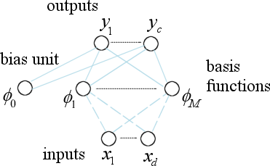
Radial Basis Function Network
Output:
Basis function:
Or,

Slide 4
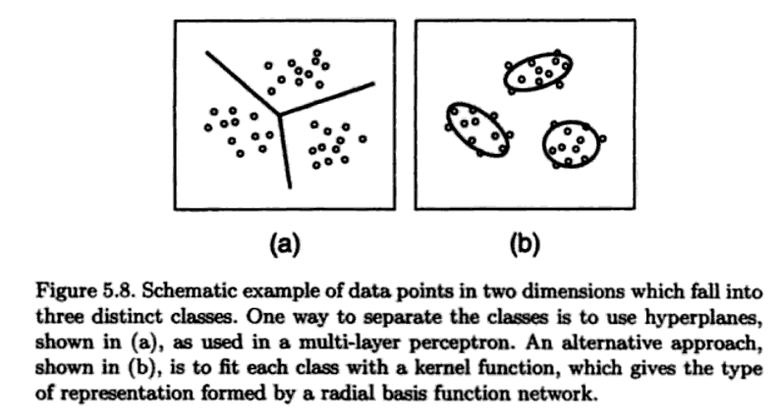
MLP and RBFN
Taken from Bishop

Slide 5
Learning RBF Network
Parameters of a RBF network
Basis function parameters: μ’s, σ’s, or Σ’s
Weights of network
Learning proceeds in two distinct steps
Basis function parameters are learned first
Next, the network weights are learned

Slide 6
Learning RBF Network Weights
Training set: (x_{i} , t_{i} ), i=1, 2, …N
RBFN output:
Squared-error:
Differentiating,
So, that’s easy!
Pseudo-inverse
For matrix differentiation see: http://matrixcookbook.com/

Slide 7
Learning Basis Function Parameters
A number of unsupervised methods are there:
Subsets of data points
Set the basis function centers, μ’s to randomly chosen data points
Set σ’s equal and to some multiple of average distance between centers
Orthogonal least square
A principled way to choose subset of data points (“Orthogonal least squares learning algorithm for radial basis function networks,” by Chen, Cowan, Grant)
Clustering
K-means
Mean shift, etc.
Gaussian mixture model
Expectation maximization technique
Supervised technique
Form squared-error and differentiate with respect to μ’s and σ’s; then use gradient descent

Slide 8
MLP vs. RBFN
Global hyperplane | Local modeling
Back-propagation training | Subset choice + LMS
Online computation time is shorter | Online computation time is typically longer
Longer learning time | Shorter learning time
Recent research trend is more in MLP than in RBFN

Slide 9
Bayesian NN: Basics
Consider a neural network with output f and weights w
Let (x_{i}, y_{i}), i=1, 2, …, N be the training set
Then for a new input x_{new} the output can thought of an expectation:
Posterior probability of weights w
How do we get Pr(w|…)?
How do we carry out this integration?
Neal, R. M. (1992) ``Bayesian training of backpropagation networks by the hybrid Monte Carlo method'', Technical Report CRG-TR-92-1, Dept. of Computer Science, University of Toronto,

Slide 10
Posterior Probability of Weights
An example posterior:
Weight decay term
Data term
Note that Pr(w|…) is highly peaked with peaks provided by the local minima of E(w)
One such peak can be obtained by say, error back-propagation (EBP) training of the network.
So, the previous expectation in principle can overcome at least two things:
Local minimum problem of say EBP, and more importantly,
Can reduce the effect of overfitting that typically occur in EBP, even with weight decay

Slide 11
How To Compute The Expectation?
Typically the computing the integration analytically is impossible.
Approximation can be obtained by Monte Carlo method, which generate
Samples w^{(k)} from the posterior distribution Pr(w|…) and take average:
Well, of course, the next question is how to efficiently generate samples from Pr(w|…)?
This precisely where the challenge and the art is hidden in Bayesian neural network.

Slide 12
Efficiently Generating Samples
For a complex network with many 2/3 hidden layers and many hidden nodes, one almost always has to resort to Markov chain Monte Carlo (MCMC) method.
Even, designing an MCMC is quite an art. Neal considers a hybrid MCMC, where the gradient direction of E(w) is efficiently used in sampling.
Also, another advantage here is that one can use ARD (automatic relevance detection) in MCMC, which can neglect irrelevant inputs. Very effective for high-dimensional problems.
Neal, R. M. (1992) ``Bayesian training of backpropagation networks by the hybrid Monte Carlo method'', Technical Report CRG-TR-92-1, Dept. of Computer Science, University of Toronto,

Slide 13
Hmm…Is There Any Success Story With BNN?
Winner of the NIPS 2003 competition!
Input sizes for 5 problems were 500, 5000, 10,000, 20,000, 100,000.
To know the nitty-gritty see
Neal, R. M. and Zhang, J. (2006) ``High dimensional classification with Bayesian neural networks and Dirichlet diffusion trees'', in I. Guyon, S. Gunn, M. Nikravesh, and L. A. Zadeh (editors) Feature Extraction: Foundations and Applications, Studies in Fuzziness and Soft Computing, Volume 207, Springer, pp. 265-295.

Slide 14
Related Neural Network Techniques
BNN is essentially a collection of neural networks
Similarly, you can think of ‘bagged’ neural networks
An aside, how is bagging different from BNN?
Boosted neural networks, etc.
Typically, care should be taken to make the neural network a weak learner with limited architecture

Slide 15
Some Interesting Features of BNN
Does not use cross-validation; so, the entire training data set can be used for learning
Flexible design: can average neural networks with different architectures!
Can work with active learning, i.e., determining relevant data
Noisy and irrelevant inputs can be discarded by ARD

